Slide 1


From CPRA to My Health, My Data Act: How to Stay Compliant with State Consumer Healthcare Privacy Laws
Paul Schmeltzer
Member at Clark Hill
(323) 497-4493
pschmeltzer@clarkhill.com
John Howard
Senior Attorney at Clark Hill
(480) 684-1133
jfhoward@clarkhill.com
July 2025

Slide 2


Agenda:
How we got here – From HIPAA/FTC to now
Growing patchwork of state consumer health privacy laws
Implications for healthcare providers and wellness organizations
Spotlight on California (CCPA/CPRA, CMIA, Delete Act, CIPA), Washington’s My Health, My Data Act, and Connecticut Data Privacy Act
Strategies for compliance and risk mitigation

Slide 3

Evolution of Health Data Protection: From HIPAA & FTC to State Consumer Health Laws
Initially, healthcare data privacy and security were primarily governed by federal laws such as HIPAA and the FTC Act.
HIPAA (1996): Established national standards for protected health information (PHI).Focused on healthcare entities (hospitals, providers, insurers). Did not cover consumer health data outside traditional healthcare systems (e.g., apps, wearables).
FTC (Federal Trade Commission): Enforces privacy practices across industries, including health data in consumer-facing products like apps via the FTC Act and Health Breach Notification Rule (2010). Primarily focused on preventing deceptive practices rather than comprehensive data protection.

Slide 4
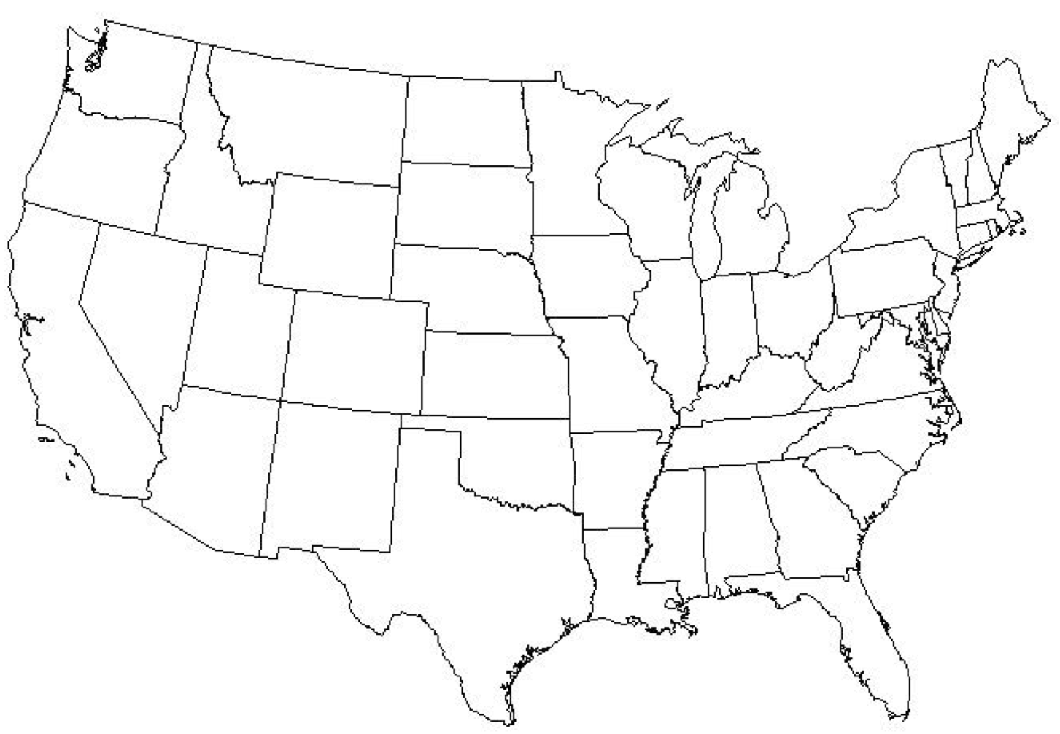
The Rise of State-Level Health Data Privacy Laws
Growing concern over gaps in federal protections and increased collection of consumer health data by non-healthcare businesses.
States like California (CCPA/CPRA), Washington (My Health My Data Act), and Connecticut (CTDPA) lead the way with comprehensive consumer health data privacy laws.
Key Features of State Laws:
  Opt-in/Opt-out Consent: Clear consumer consent for data collection.
  Transparency: Requirements to disclose how data is collected, used, and shared.
  Stronger Consumer Rights: Data access, deletion, and correction rights.
  Breach Notification: Requirements for notifying consumers of data breaches.

Slide 5

State Law Trends
Emerging Themes Across States:
Expansion of “consumer health data” beyond HIPAA’s scope
Opt-out rights for data sharing and sales
Transparency and deletion obligations
Enforcement by AGs and private rights of action
Additional enforcement actions for deceptive practices beyond FTC Act

Slide 6
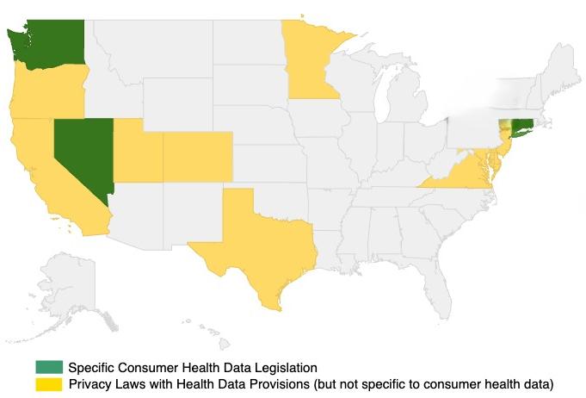
State Laws Aimed at Protecting Consumer Health Data
Broad definition of “consumer health data”
Applies to both regulated and unregulated entities
Requires affirmative opt-in for collection and sharing
Consent, access, deletion, geofencing restrictions
Private right of action = high litigation risk
Minnesota
Washington
Nevada
California
Utah
Colorado
Connecticut
Delaware
Maryland
Virginia
Texas

Slide 7


California Consumer Privacy Act (CCPA) & California Privacy Rights Act (CPRA)
                Applies to health-related personal info not covered by HIPAA
                Strengthens consumer rights: access, correction, deletion, opt-out
                Requires data minimization and purpose limitation
                CPPA enforcement + private right of action (for data breaches)

Slide 8

CPRA’s Impact on Healthcare Providers & Wellness Companies
Applies to personal health data outside HIPAA’s scope (e.g., wellness apps, digital therapeutics)
Key rights: access, correction, deletion, opt-out of sale/sharing
Business obligations: data minimization, purpose limitation, risk assessments (when processing sensitive info)
Applies even if the entity is not located in California but targets California consumers

Slide 9
Scenarios Where CCPA/CPRA May Apply to Consumer Health Data If The Business Has Annual Gross Revenue of Over $25 Million Or Collects Data on 50,000+ Consumers
Telemedicine and Health Apps: A health app or telemedicine platform collects, stores, or processes data such as personal health information, medical histories, or lifestyle data (e.g., fitness trackers).
Wearable Health Devices: A wearable device company collects health-related data (e.g., heart rate, steps, calories burned) and sells or shares this data with third parties, such as health insurers or advertisers.
Health Data Shared with Third Parties: A healthcare provider or insurance company sells or shares consumer health data (e.g., claims data, diagnoses) to third-party vendors, including for marketing purposes.
Medical Device Manufacturers and Data Sales: A company manufacturing medical devices collects consumer health data for product improvement or sells health data to marketing firms.

Slide 10

Confidentiality of Medical Information Act ("CMIA"), effective Jan. 1, 2023
Mandates state data broker registration and deletion requests
Consumers can submit one request for all registered brokers
Increased scrutiny on non-HIPAA-covered entities with health data
Effective in stages through 2026 – stay ahead with audit trails
The CMIA applies to health care providers, health plans, and any business that creates, maintains, preserves, stores, abandons, destroys, or disposes of medical information. Unlike HIPAA, which primarily focuses on electronic records, CMIA covers all forms of medical information, including written and oral communications.
The CMIA also requires explicit patient consent to disclose medical information, except in specific situations such as emergencies or when required by law.

Slide 11

California Delete Act (2023)
Mandates state data broker registration and deletion requests
Data Broker = a business that knowingly collects and sells to third parties the personal information of a consumer with whom the business does not have a direct relationship.
PI = any data that identifies, relates to, describes, is capable of being associated with, or could reasonably be linked, directly or indirectly, with a particular consumer or household
Consumers can submit one request for all registered brokers
Increased scrutiny on non-HIPAA-covered entities with health data
Effective in stages through 2026 – stay ahead with audit trails

Slide 12

The Delete Act: A Shot Across the Bow for Data Brokers
Requires all data brokers to register annually with California Privacy Protection Agency (CPPA)
Consumers can make a single deletion request to all registered brokers
Broader impact for wellness platforms that compile health-related consumer data
Full implementation by 2026 - early compliance = lower litigation risk

Slide 13

California Invasion of Privacy Act (CIPA)
CIPA prohibits interception of communications (Cal. Penal Code § 631)
Surge in class actions alleging unauthorized recording or pixel tracking on health-related websites
Applies even to passive tracking like Meta Pixel or session replay tools
Statutory damages: $5,000 per violation

Slide 14
Washington My Health My Data Act: Compliance on Steroids
  Covers “consumer health data” broadly—including mental health, fertility, biometric, and lifestyle data
  Applies to all entities collecting data from Washington residents—not just Washington-based businesses
  Requires:
      Opt-in consent for collection and sharing
      A standalone “Consumer Health Data Privacy Policy”
      Ability to revoke consent at any time
      Ban on geofencing near sensitive health locations (e.g., clinics)

Slide 15

Washington My Health My Data Act
  Broad definition of “consumer health data”
  Applies to both regulated and unregulated entities
  Requires affirmative opt-in for collection and sharing
  Consent, access, deletion, geofencing restrictions
  Private right of action = high litigation risk

Slide 16
Penalties, Litigation, and Enforcement Risks Under the Washington My Health My Data Act
  Civil Penalties: Businesses in violation of the MHMDA can be subject to civil penalties of up to $7,500 per violation. If a violation is found to be intentional, penalties may increase. The Washington State AG can initiate civil actions for violations and pursue penalties and damages in state court.
  Consumer Damages: Consumers may sue for actual damages resulting from violations of their rights under the MHMDA. Consumers also have the right to sue for statutory damages if they experience harm from the improper handling of their health data.
  Private Right of Action: Consumers can file lawsuits against businesses for violations of their health data privacy rights. Claims can involve the unauthorized collection or sharing of health data and failure to adhere to consumer data rights, such as the right to delete or access their health data.

Slide 17
Connecticut Data Privacy Act (CTDPA)
Broad definition of “consumer health data”
Applies to both regulated and unregulated entities
Requires affirmative opt-in for collection and sharing
Consent, access, deletion, geofencing restrictions
Private right of action = high litigation risk
      Applies to businesses that process personal data of Connecticut residents. Businesses must meet certain thresholds to be subject to the law, such as:
      Annual revenue of at least $25 million.
      Processing personal data of 100,000+ consumers.
      50% or more of revenue from the sale of personal data.
  Requires:
      Opt-in consent for collection and sharing
      A standalone “Consumer Health Data Privacy Policy”
      Ability to revoke consent at any time
      Ban on geofencing near sensitive health locations (e.g., clinics)

Slide 18

Connecticut Data Privacy Act (CTDPA)
      The CTDPA applies to health-related data collected by businesses if it qualifies as personal data under the law.
      Health data may be classified as sensitive data, which requires explicit consent from the consumer before it is processed, shared, or sold.
      Businesses must disclose their data collection practices, including health data, in privacy notices.
      Businesses must conduct risk assessments for activities involving personal data processing, including the handling of sensitive health data.
      The Connecticut Attorney General has the authority to enforce the law, and businesses face penalties of up to $5,000 per violation.

Slide 19
States with Privacy Laws Including Health Data Provisions
      Virginia Consumer Data Protection Act (VCDPA) - Health data is considered personal data under the VCDPA, subject to rights of access, deletion, and opt-out of sale. Does not have a specific health data privacy law but treats health data like other personal information.
      Colorado Privacy Act (CPA) - Similar to Virginia’s law, health data is protected as personal data, with provisions for access, deletion, and opt-out of data sale. Includes data minimization principles, ensuring only necessary health data is collected.
      Utah Consumer Privacy Act (UCPA) - The UCPA applies to health data as personal information, including rights to access and deletion. Utah’s law, like others, does not create a specific health data framework but ensures that personal health information is included under its consumer privacy protections.
      Nevada Privacy Law Health Data Provisions (SB 370) - Nevada’s consumer privacy law applies to personal data, including health data, requiring businesses to disclose data practices and allow opt-out of data sales. Health data is treated as personal information within the general privacy framework.

Slide 20
State Consumer Health Data Laws Under Consideration
      New York Health Information Privacy Act (Senate Bill S929 / Assembly Bill A2141) - Introduced but not yet passed.
      Key Provisions: The law aims to protect personal health data, including data collected by healthcare providers and third-party health apps.
      Consumer Rights: Consumers would have the right to access, correct, delete, and opt-out of the sale of their health data.
      Specifically addresses how businesses in the health technology space (e.g., apps, wearables) handle personal health data.
      New Mexico Health Data Privacy Act (HB 430) - Not yet passed; still under legislative review.
      Key Provisions: Proposes treating health data as a separate category of sensitive personal data, with additional protections for consumers. Businesses would be required to disclose their data collection practices related to health data. Consumers would have rights to access, correction, deletion, and opt-out provisions for health data.

Slide 21

Enforcement Trends: What Regulators Are Watching
  California AG and CPPA targeting improper “sale” or “sharing” of health data
  Pixel tracking lawsuits expanding from retail into healthcare
  Class actions under MHMD
  Delete Act may empower CPPA to target shadow health data markets

Slide 22
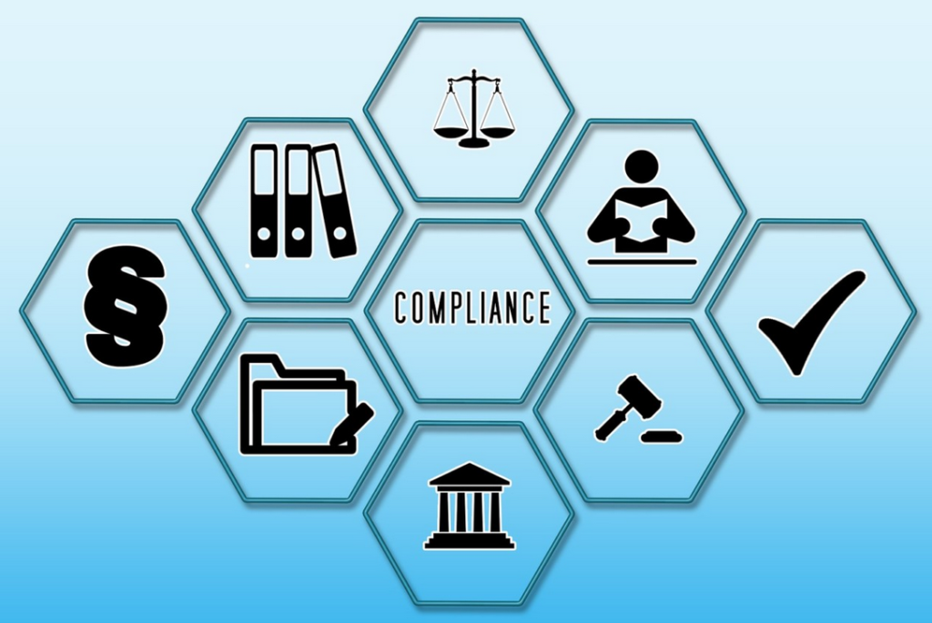
Compliance Challenges
  Overlap and divergence with HIPAA
  Growing complexity for companies to comply with varying state laws
  Tracking regulatory updates across jurisdictions
  Managing consumer rights workflows
  Aligning data governance with clinical workflows
  Balancing tech innovation with legal risk

Slide 23

Proactive Compliance Strategies
Conduct state-specific data mapping and gap assessments
Update privacy notices and consent mechanisms
Implement role-based access and data minimization practices
Train staff on multi-jurisdictional obligations
Prepare for consumer requests (access, deletion, opt-out)
Limit data retention where able
Notes:
MSSP

Slide 24

Practical Tips for Risk Mitigation
Use consent management platforms (CMPs) that support GPC signals
Establish standard operating procedures for responding to consumer rights
Establish and maintain accurate data maps
Monitor vendor and third-party data-sharing practices
Document compliance efforts for legal defensibility
Engage privacy counsel for high-risk states

Slide 25

Final Takeaways
State laws are reshaping the healthcare data privacy landscape
Non-HIPAA entities are squarely in the spotlight
Compliance requires agility, coordination, and education
Take action now to avoid enforcement risk and preserve trust

Slide 26

Questions?

Slide 27
Thank You
Legal Disclaimer
The views and opinions expressed in this material represent the view of the authors and not necessarily the official view of Clark Hill PLC. Nothing in this presentation constitutes professional legal advice nor is it intended to be a substitute for professional legal advice.
© 2023 Clark Hill PLC

